Slide 1
TEXAS POWER GRID
STUDENT NAME
INSTITUTION AFFILIATION
DATE

Slide 2
Introduction.
The electrical grid of the United States of America is made of approximately eight thousand power plants all over the country
However, the state of Texas has its own power grid. This is to ensure that their power grid did not cross the state lines to the Federal Energy regulatory commission did not interfere with the sales of electricity.

Slide 3

Regulatory party (ERCOT)
It is an independent organization responsible for monitoring major moving parts of the flowing electricity to customers.
ERCOT acts like a broker between the wholesale power purchasers and the sellers.

Slide 4
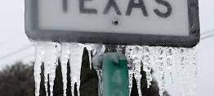
Issues involving Texas power grid
High power demands from Citizens causing delays.
Winter Storms causing outages.
Low temperatures during winter.
High temperatures during summer.

Slide 5
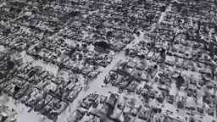

Texas power grid.

Slide 6

Power saving implementation.
Halting utilization of nonessential electricity use to balance out the electrical system,
Turning off non-essential appliances,
Avoiding the utilization of large appliances during alerts .
Slowing down, or completely shut down nonessential production processes.

Slide 7
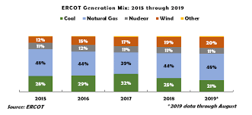
Role of government over utilities.
The local and State government ensure that alerts are issued during storms, and summer heat, and respond to power outage complains from the Texas residents.

Slide 8
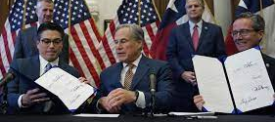
Legislation due to winter storm
(Senate bills 2 and 3).
The legislation was to ensure
changes to the governance structure overseeing the electrical market
changes to the structure of the electrical marketing itself
changes to minimize risk of future electric system disruption due to heavy winter storms

Slide 9
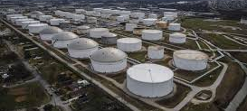
Accountability for power outage.
The Electric reliability Council of Texas (ERCOT) was held accountable.
This is because ERCOT set plans for the power grid improvements that did not come

Slide 10
Renewable energy as a complimentary source
Texas needs a renewable energy reservoir as a back up when there are power outages.
This is because renewable energy generates up to 30gigawatts could generated from natural gas, nuclear power, and gas.
However, extremely low temperatures, can still be able to snow and ice making roads impassable, thus leading to a loss in the electrical grid.

Slide 11
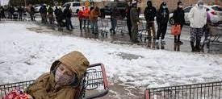
Resources during public crisis.
Shelters
Food
Clothing
Financial donation.
Support Campaigns.

Slide 12
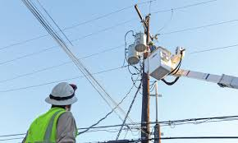
Conclusion.
The power grid of Texas stands alone to avoid the interference of the feeder government in the pricing of the market.
However, the inability of ERCOT to consider effective structural factors led to homelessness of many Texans during the storm, rendering them in need of essential supplies from good Samaritans

Slide 13
Reference.
Ofori-Boateng, D., Dey, A. K., Gel, Y. R., Li, B., Zhang, J., & Poor, H. V. (2019, June). Assessing the resilience of the Texas power grid network. In 2019 IEEE data science workshop (dsw) (pp. 280-284). IEEE.
Turner, S. W., Nelson, K., Voisin, N., Tidwell, V., Miara, A., Dyreson, A., ... & Kao, S. C. (2021). A multi-reservoir model for projecting drought impacts on thermoelectric disruption risk across the Texas power grid. Energy, 231, 120892.

